Slide 1
CH4 Lists revision + Intro to Stack & Queue

Slide 2

Agenda
Lists Revision
Stack
Queue
Image: Pixabay

Slide 3

1. List Revision
= a set of elements one after another (for ex. nodes).
Consists of Nodes
Data
Pointer or a ‘link’ to the next one
Image from Pixabay

Slide 4
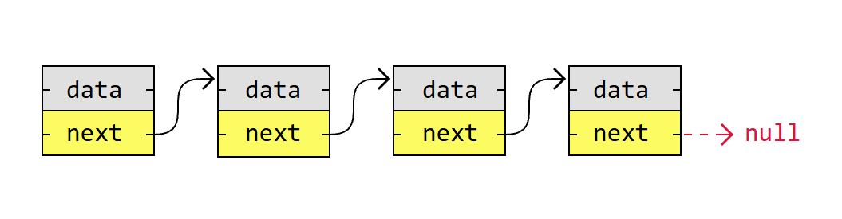
What is this?

Slide 5
A singly linked list is the simplest kind of linked lists. It takes up less space in memory because each node has only one address to the next node.

Slide 6
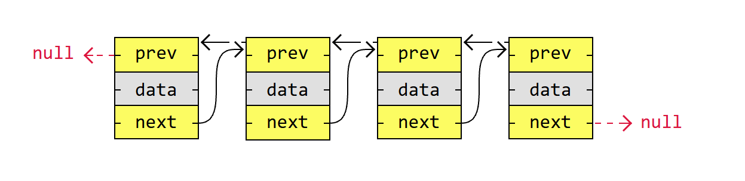
What is this?

Slide 7
A doubly linked list has nodes with addresses to both the previous and the next node, like in the image below, and therefore takes up more memory. But doubly linked lists are good if you want to be able to move both up and down in the list.

Slide 8
1.1 List Revision
Basic things we can do with linked lists are:
Traversal
Remove a node
Insert a node
Sort
Image from Pixabay

Slide 9
1.1 List Revision
Let’s practice again ☺
Create a class Node for a linked list
Data
Link/pointer
Pseudo code:
Class Node
def Init
data
pointer to next node (None)
Image from Pixabay

Slide 10
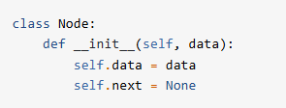
1.1 List Revision
Let’s practice again ☺
Create a class Node for a linked list
Data
Link/pointer
Pseudo code:
Class Node
def Init
data
pointer to next node (None)
Image from Pixabay

Slide 11
1.2 List Revision
Let’s continue this:
Create 5 nodes with different data
Link them to each other (assign “next”)
Create a function that goes through all the nodes and prints them
def printNodes(head)
assign first node as head
loop through the noes and print data (while)
print “null” or “end” at the end after iterating
Image from Pixabay

Slide 12
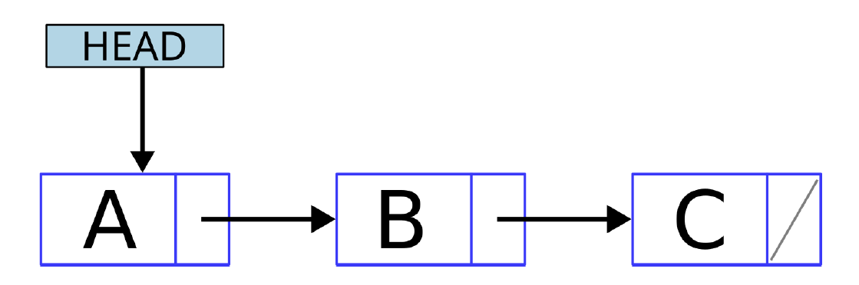
class Node: def __init__(self, data): self.data = data self.next = None def printNodes(head): currentNode = head while currentNode: print(currentNode.data, end=" -> ") currentNode = currentNode.next print("null") node1 = Node(7) node2 = Node(11) node3 = Node(3) node4 = Node(2) node5 = Node(9) node1.next = node2 node2.next = node3 node3.next = node4 node4.next = node5 printNodes(node1)

Slide 13
1.3 List Revision
Let’s go a bit further now:
Now let’s create a new class for the LinkedList
The only information you need to store for a linked list is where the list starts (the head of the list).
class LinkedList
Init
set the head
Image from Pixabay

Slide 14
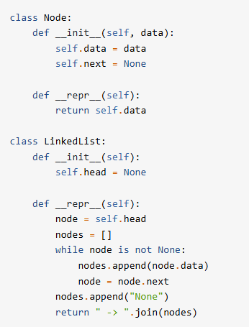
1.3 List Revision
It’s a pretty basic class as you can see.
We have now also added __repr__ (represent) methods to the Node and LinkedList classes so that displaying them is easier. Copy them from here!
TODO:
Create a Linked List using the code you wrote.
Create three nodes a, b and c.
Set the head of the list
Set the pointers of the nodes
Print the list
Image from Pixabay

Slide 15
class Node:
def __init__(self, data):
self.data = data
self.next = None
def __repr__(self):
return self.data
class LinkedList:
def __init__(self):
self.head = None
def __repr__(self):
node = self.head
nodes = []
while node is not None:
nodes.append(node.data)
node = node.next
nodes.append("None")
return " -> ".join(nodes)
llist = LinkedList()
first_node = Node("a")
llist.head = first_node
second_node = Node("b")
third_node = Node("c")
first_node.next = second_node
second_node.next = third_node
print(llist.__repr__())

Slide 16
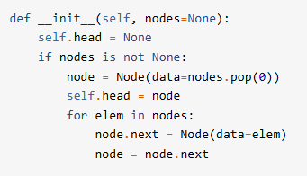
1.4 List Revision
If you want to make the creation of the LinkedList a bit nicer and easier, you can copy this new __init__ method.
Final task of Lists today:
Create a method for the LinkedList to traverse it (go through the nodes)
Print the list
Def iter
- create a variable and assign it head (start)
- iterate until node is not none (while)
- yield node
- node = node.next
Print the nodes of list at end of program using a for loop.
Image from Pixabay

Slide 17
def __iter__(self):
node = self.head
while node is not None:
yield node
node = node.next
llist = LinkedList(['a', 'b', 'c', 'd'])
for node in llist:
print(node)
You have new homework exercises at OMA ☺
Insert at Start
Insert at End
Insert between Two Nodes
Remove a Node

Slide 18

2. Stack
ADT = Abstract Data Structure
It is a concept that can be recreated in any coding language.
LIFO = Last-In/First-Out
Last element we put in, is the first one to be taken out
Can be implemented using a Linked List for example or in many other ways!
Let’s look at a code example and do one together!
Image from GettyImages

Slide 19

3. Queue
ADT = Abstract Data Structure
FIFO = First-In/First-Out
First element we put in, is the first one to be taken out
Can also be implemented using a Linked List for example or in many other ways!
Let’s look at a code example and do one together!
Image from Freepik

Slide 20
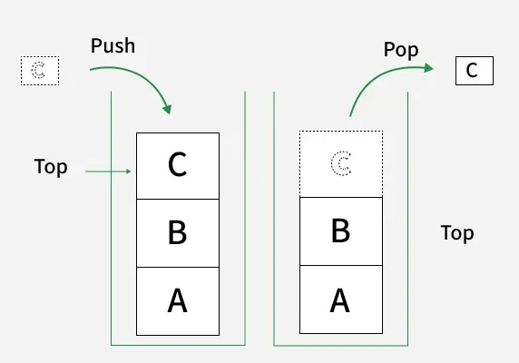
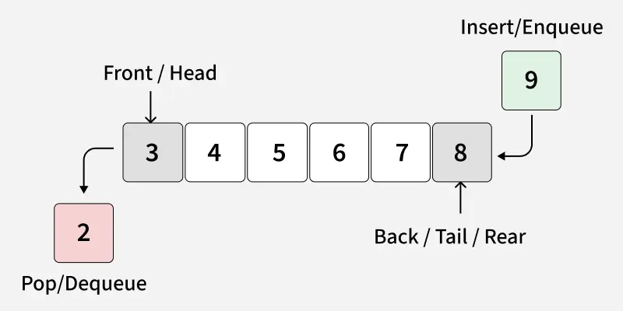
Stack
Queue

Slide 21
See you next time!
tino.kankkunen@metropolia.fi

